Slide 1
Machine Learning based System for Personalized Job Role Recommendations and industry specific tailoring
VIGNESHWARAN G (210701307) PROJECT COORDINATOR
VISHVA A (210701314) DR.P.SHANMUGAM,M.Tech,Ph.D.,
VINOTH RAJ G (210701509) ASSOCIATE PROFESSOR(CSE)

Slide 2
ABSTRACT
The system collects job-related information from industry information website, including factors such as job title, salary estimates, company ratings, location, industry, and more. By analyzing this data, we aim to generate accurate recommendations tailored to the user’s skills, interests, and career goals.
Key components of our system include:
Data Scraping: We scrape relevant job data from industry information website to build our recommendation system.
Feature Engineering: We preprocess and transform raw data, handling missing values, encoding categorical variables, and normalizing numerical features.
Machine Learning Techniques: We employ TF-IDF (Term Frequency-Inverse Document Frequency) vectorization to capture the importance of words in job descriptions and user preferences. This enables the system to find similar job opportunities.
Our system not only recommends relevant job roles but also facilitates connections with industry experts. By combining data scraping, machine learning, and cloud deployment, we create an AI-powered solution that benefits both job seekers and employers.

Slide 3
EXISTING SYSTEM
Data Collection:
  User profiles: This includes skills, experience, education, and potentially interests or career goals.
  Job postings: Information about the role, required skills, and desired experience.
Recommendation Techniques:
  Content-based filtering: Matches user profiles based on keywords and skills listed in job descriptions.
  Collaborative filtering: Recommends jobs similar to those preferred by users with similar profiles.
  Hybrid approaches: Combine content-based and collaborative filtering for a more comprehensive recommendation.

Slide 4
PROPOSED SYSTEM
Dynamic Learning and Feedback Integration:
  Continuously learn from user interactions, including clicks, applications, and job acceptance/rejection data.
  Allow users to provide feedback on recommendations to refine the system's accuracy over time.
Long-term Career Path Insights:
  Move beyond just immediate job openings.
  Recommend courses, skill development programs, and networking opportunities based on the user's long-term career aspirations.
Advanced Job Description Analysis:
  Utilize Natural Language Processing (NLP) to understand the context and intent behind job descriptions.
  Extract not just keywords but also the tone, company culture, and required soft skills

Slide 5
PROPOSED SYSTEM
Multi-faceted User Profiling:
  Go beyond just skills and experience.
  Include assessments to gauge cognitive abilities, personality traits, and work style preferences.
  Integrate with learning platforms to capture users' course completion and interests in emerging fields.
Hybrid Recommendation with Explainability:
  Combine content-based, collaborative filtering, and a knowledge graph approach.
  Leverage a knowledge graph to connect skills, roles, and career paths for a more holistic view.
  Provide users with clear explanations for why specific jobs are recommended. This could involve highlighting relevant skills mentioned in their profile or explaining how the job aligns with their career goals gleaned from assessments.

Slide 6
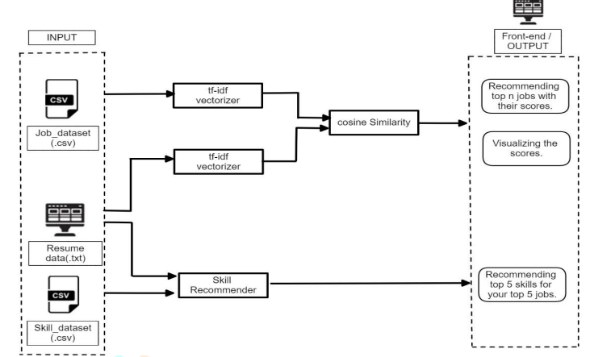
SYSTEM ARCHITECTURE

Slide 7
MODULES IN THE SYSTEM
Data Collection: Gather job postings and resumes.
Preprocessing: Clean and transform the data.
Feature Extraction: Extract relevant features from the text data.
Model Training: Train machine learning models to match job roles with candidate profiles.
Recommendation: Use the trained models to recommend job roles to candidates.
Deployment: Deploy the recommendation system and monitor its performance.

Slide 8
MODULES IN THE SYSTEM
Data Collection and Preprocessing: Gather job postings and resumes.
  Data Sources
  Data Cleaning
  Data Transformation
Feature Extraction: Extract relevant features from the text data.
  Text Features
    Tokenization
    Stemming/Lemmatization
    Stop word removal
    TF-IDF
    Word Embeddings
  Numerical Features

Slide 9
MODULES IN THE SYSTEM
Model Training: Train machine learning models to match job roles with candidate profiles.
  Classification models
  Ranking models
  Training
  Validation and testing
  Metrics
Recommendation and Deployment: Use the trained models to recommend job roles to candidates.
  Skill extraction
  Profile building
  Similarity metrics
  Real time processing

Slide 10
Result and discussion

Slide 11
RESULT AND DISCUSSION
A job role recommendation system using machine learning (ML) leverages algorithms to analyze a candidate's skills, experience, and preferences to suggest the most suitable job roles. The system typically employs Natural Language Processing (NLP) to understand job descriptions and resumes, and uses clustering or classification techniques to match candidates with roles. ML models such as decision trees, support vector machines, and neural networks can predict job fit based on historical hiring data and candidate profiles.
This results in a more efficient hiring process, as the system can quickly filter and rank potential roles, reducing the time and effort required by human recruiters. Additionally, the system improves candidate satisfaction by aligning job opportunities with their qualifications and career aspirations, ultimately leading to better job performance and reduced turnover rates. By continuously learning from new data, the recommendation system becomes more accurate over time, adapting to changing job market trends and candidate profiles.

Slide 12
CONCLUSION
The proposed model presents a significant advancement in the realm of career guidance and employment matching. Through the utilization of machine learning algorithms, it offers tailored recommendations for job roles based on individual skills, preferences, and industry requirements. This innovative system not only streamlines the job search process for individuals but also enhances workforce efficiency by aligning candidates with positions that best suit their capabilities. With its potential to revolutionize recruitment processes and optimize workforce utilization, this project marks a pivotal step towards a more personalized and effective approach to employment placement in diverse industries.

Slide 13
FUTURE ENHACEMENT
Explainability and Transparency: Incorporate methods to explain how the recommendations are generated, increasing user trust and understanding of the system.
Personalization and Customization: Allow users to provide feedback and customize their preferences, such as preferred job locations, salary range, company size, etc., to tailor recommendations more accurately to individual needs.

Slide 14
Blank slide
THANK YOU

